Slide 1
Assignment based Subjective Questions

Slide 2
1. From your analysis of the categorical variables from the dataset, what could you infer about their effect on the dependent variable?
Analyzing the effect of categorical variables on the dependent variable involves exploring the relationships between these variables and the outcome of interest. This allowed us to observe any trends or differences in the dependent variable across categories. By visualization we were able to identify potential patterns, outliers, or variations.

Slide 3
2. Why is it important to use drop_first=True during dummy variable creation?
The parameter drop_first=True is used to prevent multicollinearity in regression models.
The dummy variable trap occurs when the dummy variables created for a categorical variable are highly correlated, leading to problems in the estimation and interpretation of regression coefficients. By setting drop_first=True, we can automatically exclude one of the dummy variables for each categorical variable, eliminating the trap.

Slide 4
3. Looking at the pair-plot among the numerical variables, which one has the highest correlation with the target variable??
atemp, has the highest correlation with the target variable

Slide 5
4. How did you validate the assumptions of Linear Regression after building the model on the training set?
Validating the assumptions of linear regression is a crucial step after building a model on the training set.
Here we used outliner detection, Multicollinearity check.
Identify and investigate potential outliers by examining standardized residuals. Outliers can significantly impact the model and assumptions.
High VIF values may indicate problematic multicollinearity, which can affect coefficient estimation and interpretation.

Slide 6
5. Based on the final model, which are the top 3 features contributing significantly towards explaining the demand of the shared bikes??
temp', 'atemp', 'hum'

Slide 7
General Subjective Questions

Slide 8
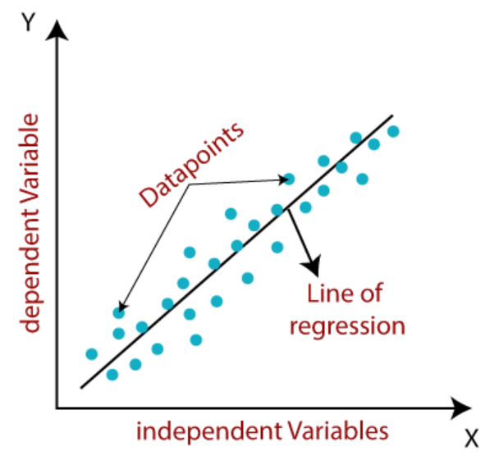
1. Explain the linear regression algorithm in detail.
Linear regression is an algorithm that provides a linear relationship between an independent variable and a dependent variable to predict the outcome of future events.
It is a supervised learning. It is mostly used for finding out the relationship between variables and forecasting.
Linear regression shows the linear relationship between the independent variable (X-axis) and the dependent variable (Y-axis). The linear regression model gives a sloped straight line describing the relationship within the variables.

Slide 9
Mathematically linear regression can be represented- by:
y= a0+a1x+ ε
Y= Dependent Variable (Target Variable)
X= Independent Variable (predictor Variable)
a0= intercept of the line (Gives an additional degree of freedom)
a1 = Linear regression coefficient (scale factor to each input value).
ε = random error
The values for x and y variables are training datasets for Linear Regression model representation.
Linear Regression may further be divided into
1. Univariate Linear regression
2. Multivariate Linear Regression
If there is a single input variable (x), such linear regression is called simple linear regression.
And if there is more than one input variable, such linear regression is called multiple linear regression.

Slide 10
2. Explain the Anscombe’s quartet in detail.
Anscombe’s quartet is a set of four dataset that have identical descriptive statistical properties in terms of means, variance, R-Squared, correlations and linear regression lines but having different representations when we scatter plot on graph. Each dataset consists of eleven (x, y) points. The datasets were created to demonstrate the importance of visualizing data and to show that summary statistics alone can be misleading.
Anscombe’s quartet is used to illustrate the importance of exploratory data analysis and the drawbacks of depending only on summary statistics. It also emphasizes the importance of using data visualization to spot trends, outliers, and other crucial details that might not be obvious from summary statistics alone.

Slide 11
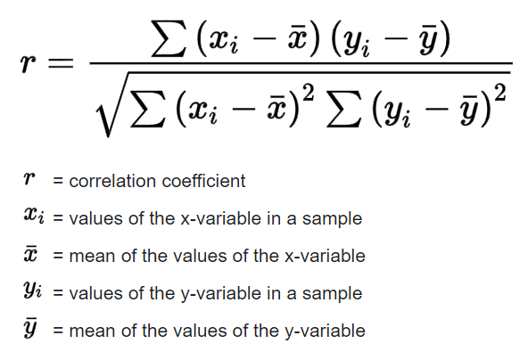
3. What is Pearson’s R?
The Pearson correlation coefficient is a descriptive statistic, meaning that it summarizes the characteristics of a dataset. Specifically, it describes the strength and direction of the linear relationship between two quantitative variables.
It is a number between –1 and 1 with +1 representing a positive correlation, -1 representing a negative correlation, and 0 representing no relationship. When one variable changes, the other variable changes in the same direction.
It can be represented by the formula:

Slide 12
4. What is scaling? Why is scaling performed? What is the difference between normalized scaling and standardized scaling?
Scaling is a step of data Pre-Processing which is applied to independent variables to normalize the data within a particular range. It also helps in speeding up the calculations in an algorithm.
Most of the times, collected data set contains features highly varying in magnitudes, units and range. If scaling is not done then algorithm only takes magnitude in account and not units hence incorrect modelling. To solve this issue, we have to do scaling to bring all the variables to the same level of magnitude.
It is important to note that scaling just affects the coefficients and none of the other parameters like t-statistic, F-statistic, p-values, R-squared, etc.

Slide 13
Normalized Scaling:
It brings all the data in the range of 0 and 1. sklearn.preprocessing.MinMaxScaler helps to implement normalization in python.
Normalized Scaling(x) = (x - min(x))/(max(x) – min(x))
Standardization Scaling:
Standardization replaces the values by their Z scores. It brings all the data into a standard normal distribution which has mean (μ) zero and standard deviation one (σ).
Normalized Scaling(x) = (x - mean(x))/sd(x)

Slide 14
Normalized Scaling | Standardization Scaling
Normalized scaling is helpful when the feature distribution is unclear, and data's distribution does not match a Gaussian distribution. A practical transformation approach that helps the model perform and be more accurate is normalization. | Standardization Scaling is helpful when feature distribution is consistent and you are entirely aware of the feature distribution of your data or when your data has a Gaussian distribution.
Normalized scaling additionally known as scaling normalization, values on the scale fall between [0, 1] and [-1, 1]. | Standardization Scaling is called Z-score normalization, values on a scale are not constrained to a particular range.
This method scales the model using minimum and maximum values. | This method scales the model using the mean and standard deviation.
When features are on various scales, it is functional. | When a variable's mean and standard deviation are both set to 0, it is beneficial.

Slide 15
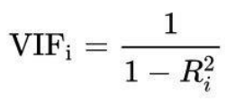
5. You might have observed that sometimes the value of VIF is infinite. Why does this happen?
Formula for calculating VIF is:
IF VIF is infinite that means that Ri^2 value is = 1. It indicates a perfect linear relationship between the i-th variable and the other independent variables. This situation occurs when there is a perfect multicollinearity.
Perfect multicollinearity occurs when one or more independent variables in a regression model can be exactly predicted from the others. This leads to a situation where the correlation matrix of the independent variables is singular, and the inverse of the matrix doesn't exist, resulting in an infinite VIF.

Slide 16
6. What is a Q-Q plot? Explain the use and importance of a Q-Q plot in linear regression.
A Quantile-Quantile (Q-Q) plot is a graphical tool used to assess whether a dataset follows a particular theoretical distribution. As the name suggests, they plot the quantiles of a sample distribution against quantiles of a theoretical distribution. Doing this helps us determine if a dataset follows any particular type of probability distribution like normal, uniform, exponential.
Q-Q plot is a valuable tool for assessing the normality of residuals in linear regression. It provides a visual check of the assumptions and aids in identifying potential issues that may affect the reliability of the regression analysis. Researchers and statisticians use Q-Q plots in conjunction with other diagnostic tools to ensure the robustness and validity of their regression models.

